Slide 1
Beginning of the Year Procedures
INTRODUCTION

Slide 2
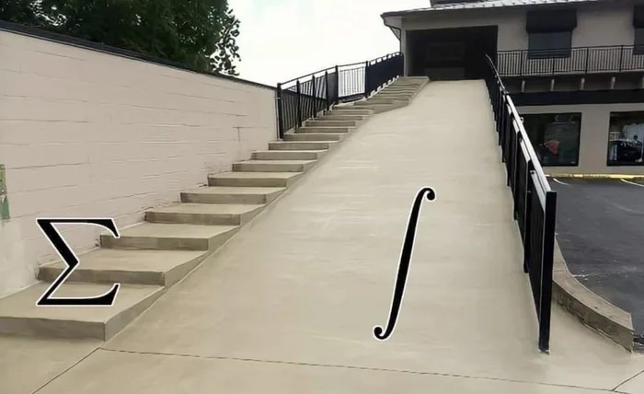
Why Study Discrete Math?
Discrete Mathematics is the study of discrete (not continuous) objects
▷ Unlike Calculus (no limits, continuity, differentiation)
source: Google images

Slide 3
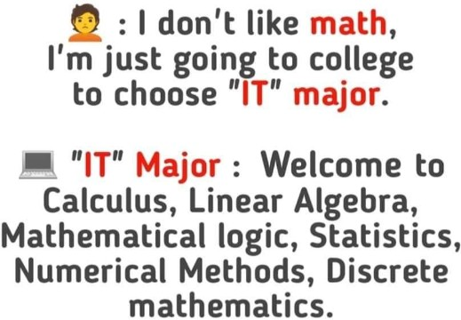
Why Study Discrete Math?
Computer Science = Problem Solving
Mathematics is at the heart of problem solving
definition, modeling, solution, analysis
Computers are discrete objects operating one discontinuous (discrete) step at a time
Discrete mathematics is the right framework for describing precisely CS concepts
source: ProgrammerHumor.io
Computer Science is no more about computers than astronomy is about telescopes.
Edsger Dijkstra

Slide 4
Why Study Discrete Math?
Conceptual core of computer science is Algorithm
Discrete Mathematics helps provide techniques to design algorithms
methods to prove the correctness of algorithms tools to analyze algorithms

Slide 5
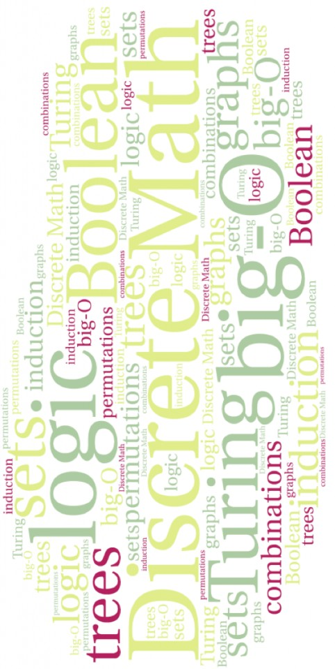
Why Study Discrete Math? Topics
source: Colorado State University | Topic
 | Logic
 | Sets
 | Functions
 | Sequence and Sums
 | Recursion and Recurrences
 | Proofs
 | Induction
 | Counting
 | Relations
 | Graphs
 | Trees
 | Number Theory

Slide 6
Why Study Discrete Math? Topics
Logic:
Fundamental to all mathematical disciplines Useful for hardware design, computer architecture
Artificial Intelligence, Natural Language Processing, Knowledge Representation

Slide 7
Why Study Discrete Math? Topics
Sets:
Fundamental to all mathematical disciplines
Provide foundations for various CS disciplines, especially
Data Structures Algorithms Probability Database

Slide 8
Why Study Discrete Math? Topics
Functions, Relations, Recurrences:
Building blocks for
Hashing Cryptography
Programming Languages Database systems
Recursive Algorithm Analysis

Slide 9
Why Study Discrete Math? Topics
Proofs:
that your program has no bug Verify that the hardware is correct

Slide 10
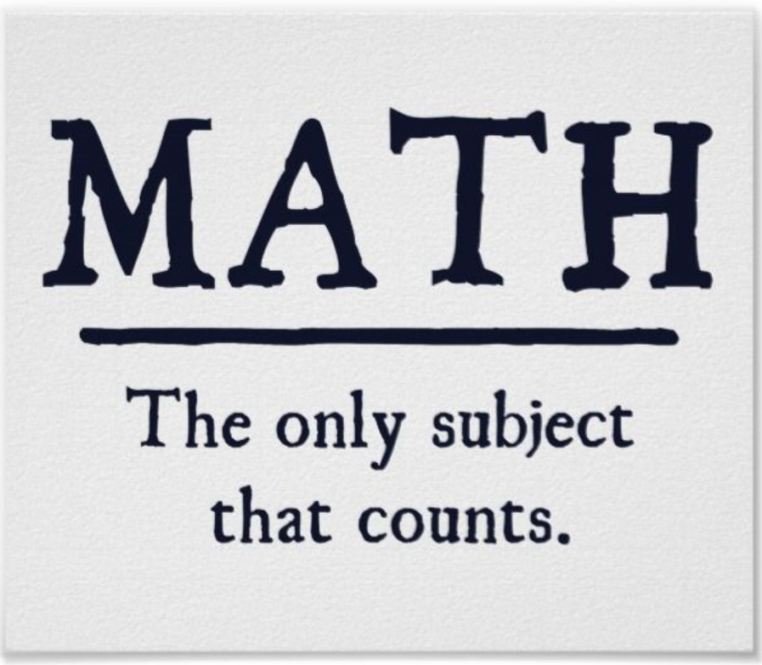
Why Study Discrete Math? Topics
Counting and Combinatorics:
Calculate your chances of a component failure Analyze how long a program takes to finish Very useful in designing algorithms
credit: https://zazzle.com/

Slide 11
Why Study Discrete Math? Topics
Graph Theory:
Provide techniques for many clever data-structures for organizing information
Many problems are modeled and efficiently solved using graphs particularly problems in Networks, Operating systems, Database

Slide 12

Applications: Logic
In a certain island there are two types of people
source: Matthew Sgambati, UMD
Knights always tell the truth Knaves always lie

Slide 13
Applications: Logic
A says: “Both of us are knights”
B says: “A is a knave”
Suppose A is a knight. What A says is true
B is a knight. What B says is true
▷ IMPOSSIBLE
A is a knave
Result: A is knave, B is knight

Slide 14
Applications: Logic
A says, “I am a knave or B is a knight”
B says nothing
Result: Both are knights

Slide 15
Applications: Counting
8 | 9 | 3 | 4 | 2
2 | 3 | 4 | 8 | 9
Sort
for i = 1 to n − 1 for j = i + 1 to n
if (A[i ] > A[j])
exchange A[i ] and A[j]
How many times is the comparison made?

Slide 16
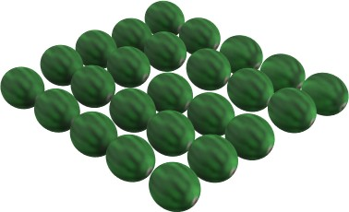
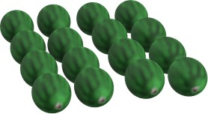
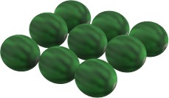


Applications: Counting
How many watermelons are in each group?
5 5
4 4
3 3
2 2
1 1

Slide 17
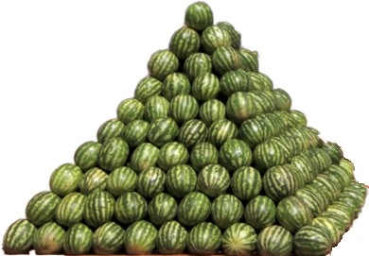
Applications: Counting
How many watermelons in this square base pyramid ?
₁2
+ ₂2
+ ₃2
+ ₄2
+ ₅2
+ ₆2
+
.

Slide 18
Applications: Counting
How many passwords can be made from the characters
{a, b, f , g , h, l , m, o, t, u}
Length of password is 10 but no repetition
No password contain the word ‘gulf’, ‘math’ or ’boat’.
How many rooms are needed to schedule 300 exams in one week?
08:00AM
10:00AM
10:00AM
12:00PM
12:00PM
02:00PM
02:00PM
04:00AM
04:00PM
06:00AM
06:00PM
08:00PM
No two simultaneous exams in a room
6 time slots per day in the exam week (7 days)

Slide 19
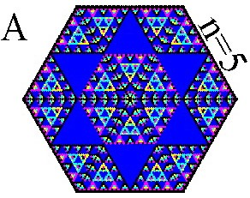
Write a small piece of code to draw this pattern in color
Applications: Counting

Slide 20
Applications: Recurrences
The Josephus Problem: Matter of Life and Death
During the Jewish-Roman war, Falvius Josephus was among 41 soldiers trapped in a cave. They preferred suicide over capture and formed a circle. Going around the circle, they killed every third remaining person until no one was left. But Josephus and another person survived.
He was lucky!
No, he knew Discrete Mathematics

Slide 21
Applications: Recurrences
The Josephus Problem (a variant)
10 People numbered 1 to 10, n = 10
Every other person is killed starting with number 2. Which person survives? What is J(10)?

Slide 22
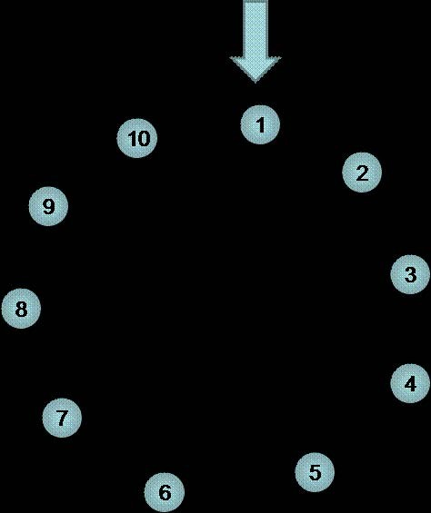
Applications: Recurrences

Slide 23
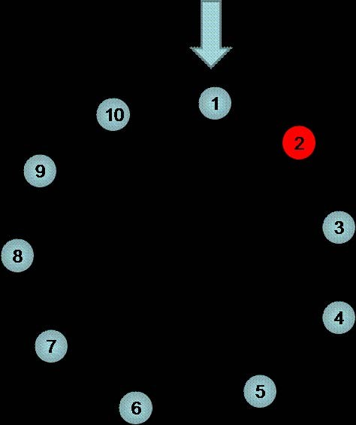
Applications: Recurrences

Slide 24
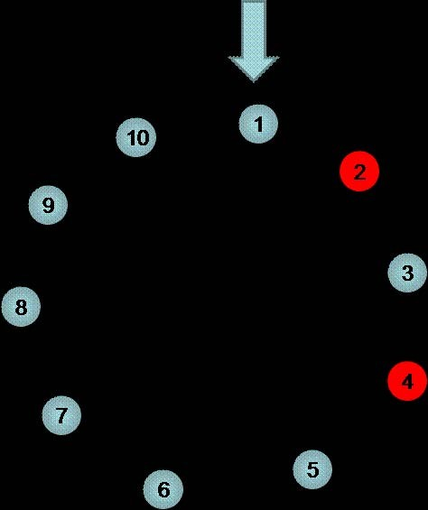
Applications: Recurrences

Slide 25
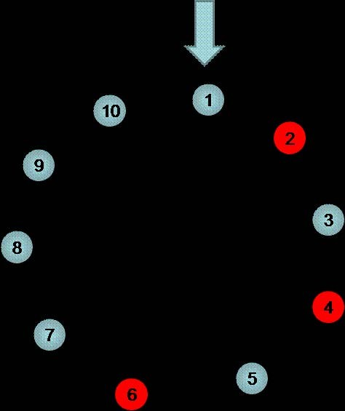
Applications: Recurrences

Slide 26
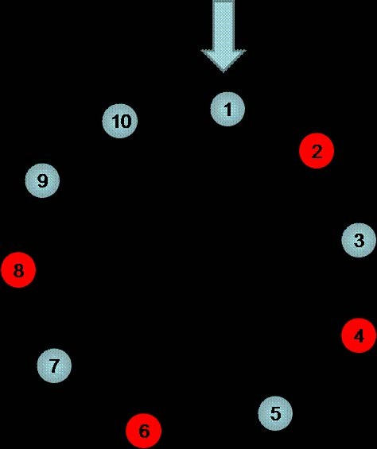
Applications: Recurrences

Slide 27
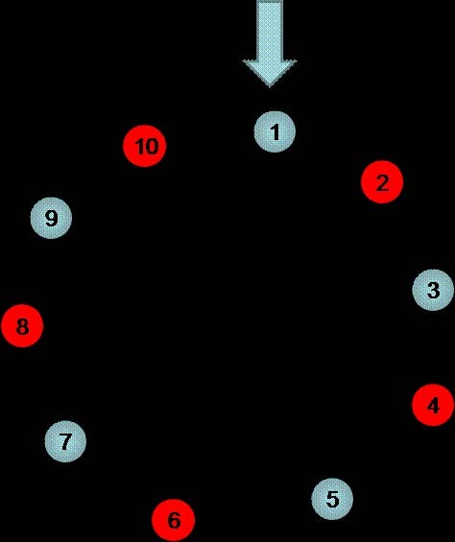
Applications: Recurrences

Slide 28
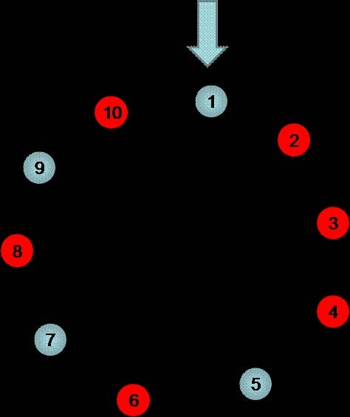
Applications: Recurrences

Slide 29
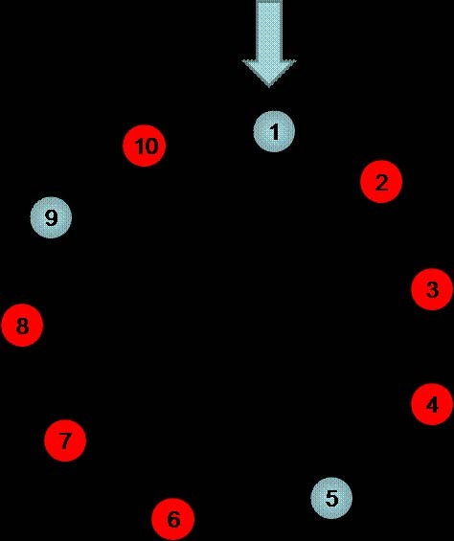
Applications: Recurrences

Slide 30
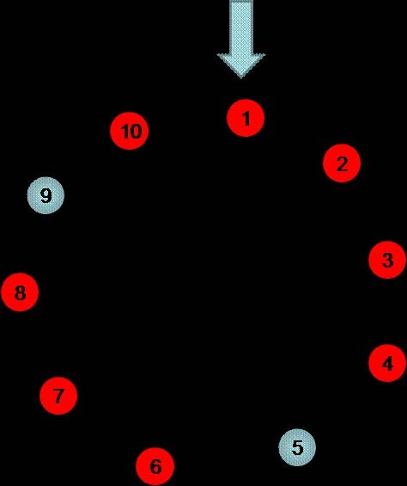
Applications: Recurrences

Slide 31
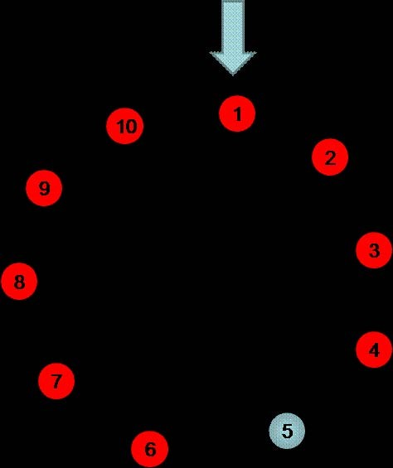
Applications: Recurrences

Slide 32
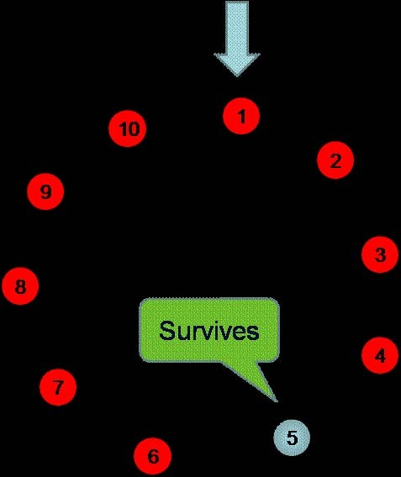
Applications: Recurrences

Slide 33
Applications: Recurrences
J(10) = 5

Slide 34
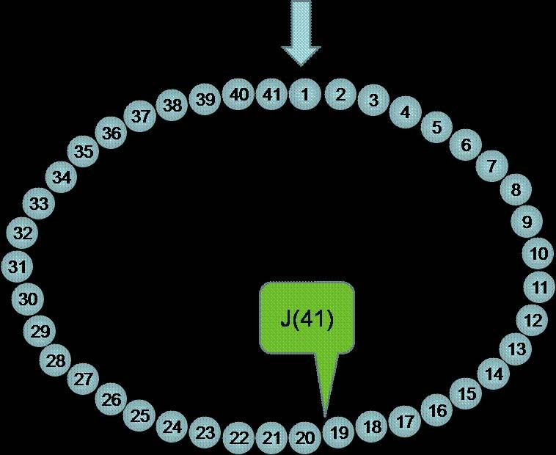
Applications: Recurrences

Slide 35
Applications: Recurrences
n | J(n)
1 | 1
2 | 1
3 | 3
4 | 1
5 | 3
6 | 5
7 | 7
8 | 1
9 | 3
10 | 5
11 | 7

Slide 36
Applications: Recurrences
Josesphus knew Discrete Mathematics, Recurrence (Week 8)
J(1) = 1
J(2n) = 2J(n) − 1,
J(2n + 1) = 2J(n) + 1,
for n ≥ 1
for n ≥ 1

Slide 37
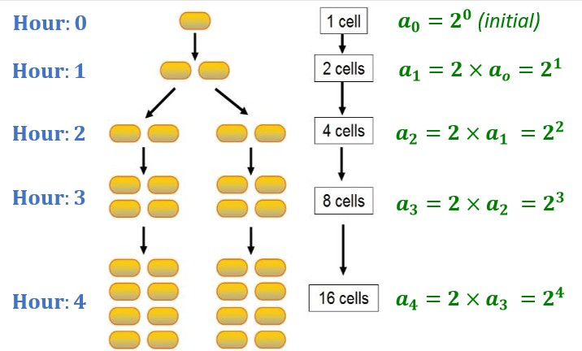
Applications: Recurrences
Bacteria Doubling Every Hour
Let a_{n} be the number of bacteria at hour n. What is a_{n}?

Slide 38
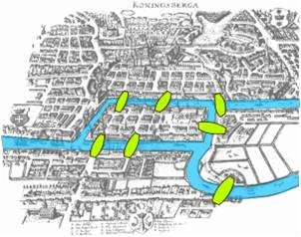
Applications: Graphs
Tour the building/place passing each door/building exactly once

Slide 39
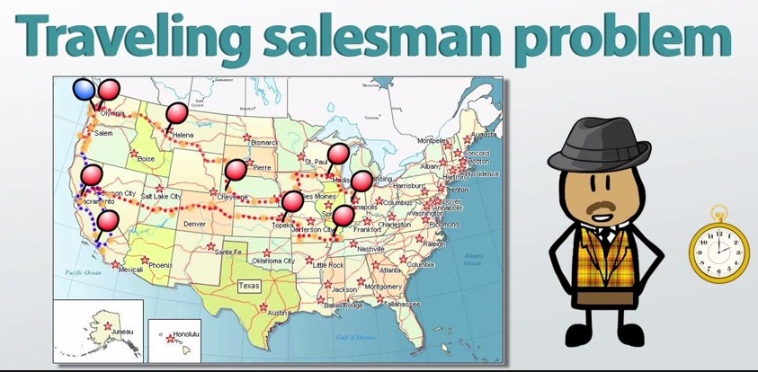
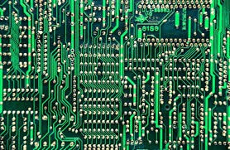

Applications: Graphs
A salesman wants to visit all cities with minimum cost Optimize the tool path for manufacturing equipment
credit: study.com

Slide 40
Applications: Graphs
Google Maps utilizes discrete mathematics, particularly graph theory, to provide users with optimal routes and real-time traffic information.
Graph algorithms like Dijkstra’s algorithm and A search algorithm enable efficient route planning, considering factors such as distance, traffic congestion, and road closures.

Slide 41
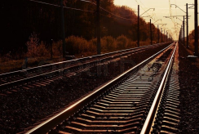
Applications: Graphs
Railway planning involves intricate scheduling and optimization problems that can be effectively tackled using discrete mathematics techniques. Graph theory helps in modeling railway networks, optimizing train schedules, and minimizing conflicts between trains, thereby enhancing efficiency and safety.

Slide 42
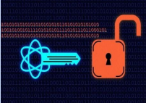
Applications: Number theory
Cryptography, the study of secure communication, heavily relies on discrete mathematics concepts such as modular arithmetic, number theory, and combinatorics.
The best known application of number theory is public key cryptography, such as the RSA algorithm.

Slide 43
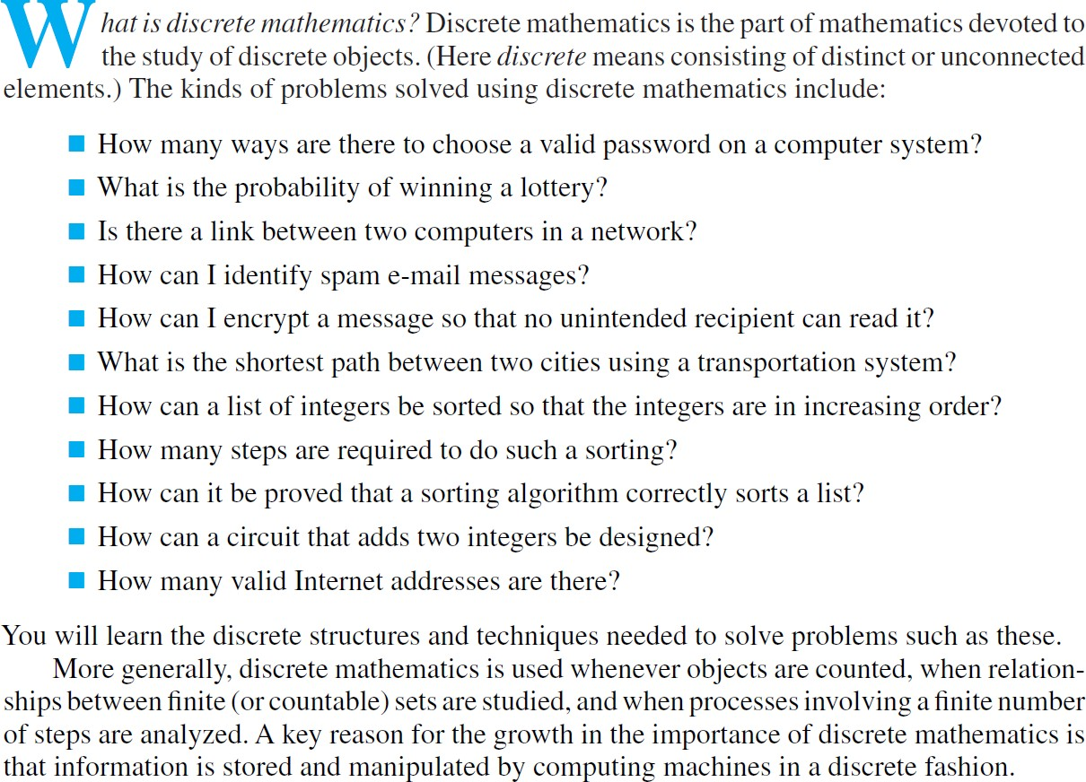
Why Study Discrete Mathematics (Textbook backcover)

